Slide 1
Senior Year!
Planning for graduation and beyond!

Slide 2
Who is my counselor?
GENERAL/BE 3&4/SE Bilingual Levels 1&2
Ms. Caboy A, D-F Ms. Gimenez A-G
Mr. Cano B Mr. Cano H-O
Ms. McMorrow C Ms. Cepin P-Z
Ms. Gimenez G
Ms. Kahn H-Ma
Dr. Levine Mc-Pa
Ms. Cepin Pe- Re
Ms. Otterbine Ri-Sh
Ms. Zaretsky Si-Z

Slide 3
Understanding Graduation Requirements
130 credits
Passing score on assessment: SAT, ACT, PSAT, ASVAB, NJSLA
Passing grades in the following courses:
4 years of English or ESL
2 years of World Language (Spanish, Italian, French)
3 years of Mathematics (Algebra 1, Geometry, Algebra 2)
3 years of Lab Science (Physics or Envir. Science, Chemistry, Biology)
3 years of Social Studies (World History, US History 1, US History 2)
4 years of PE/Health
1 course in 21st Century Life & Career or Career -Technical Education
1 course in Visual & Performing Arts
½ year Financial Literacy (this is a half year course)

Slide 4
IC PORTAL
Attendance
Grades
Transcripts- GPA, Audit
Schedule

Slide 5
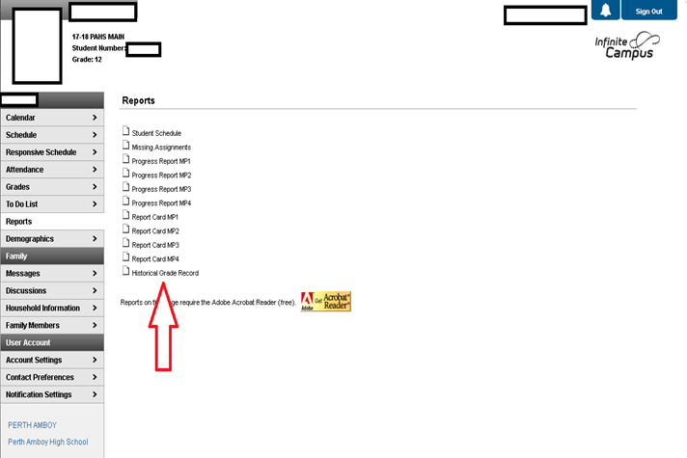
Transcripts

Slide 6
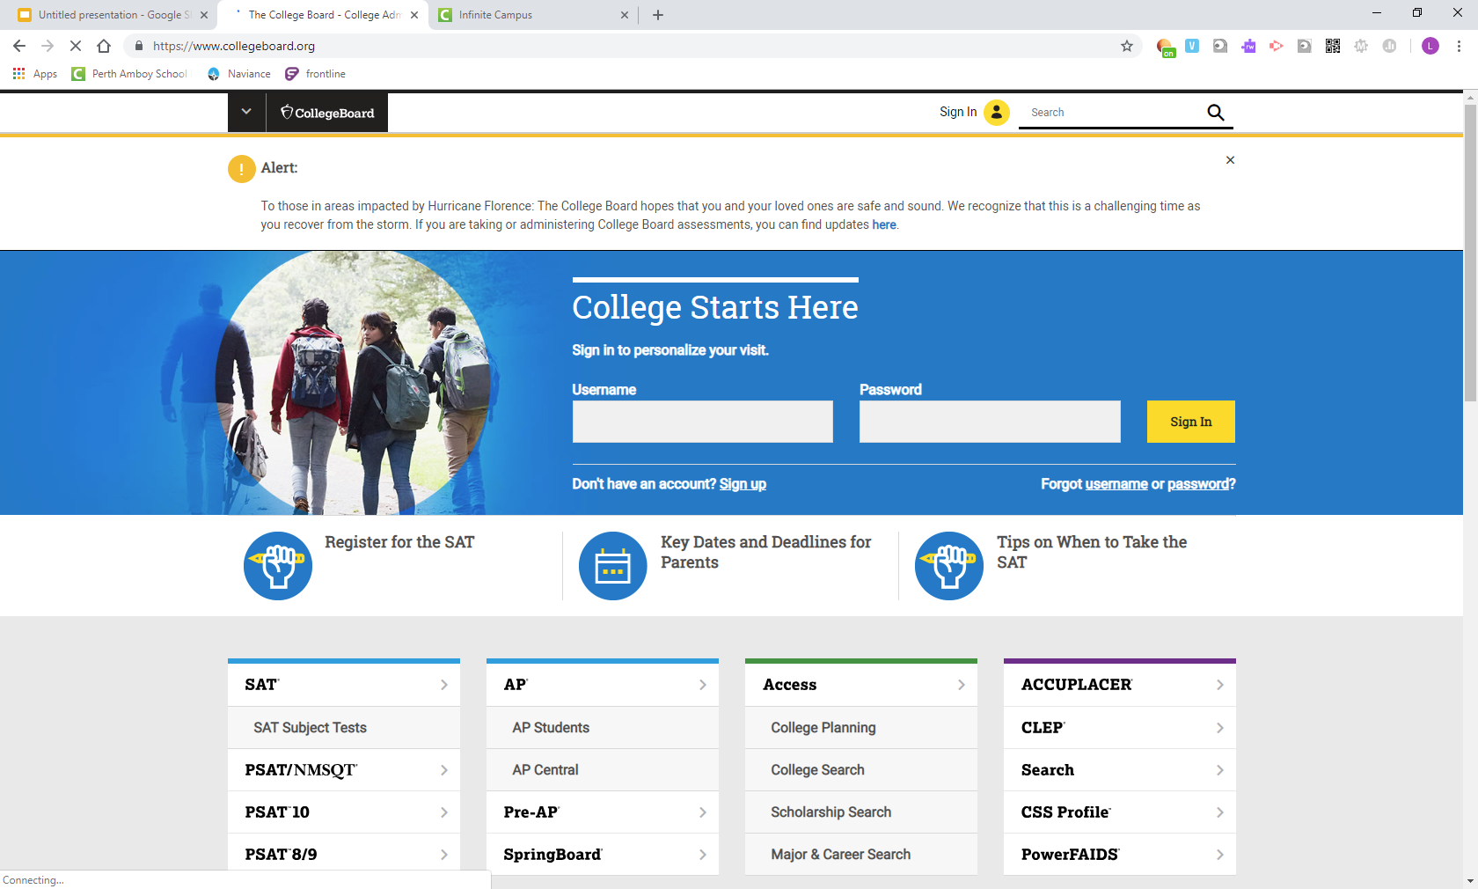
Collegeboard.com- register for SAT and send scores to colleges
You will all take the SAT in school next week! If you want to take another SAT exam or a subject test The best dates for seniors are…..
Nov 2
Dec 7 (given @ PAHS)
ACTSTUDENT.ORG
To register for Dec 14th

Slide 7
College and career readiness program to help you prepare for life after high school
This tool helps you and your counselor plan together
You can:
Search for colleges, save them to a list, keep track of your applications and request recommendation letters
Explore Careers, build a resume, take career interest inventories
Search for scholarships
Sign up for college trips and visits
Connection.naviance.com/perthah
(must type exactly as above - you can also find this link on the high school website)
Username: school issued user name Password: 6 digit school ID number

Slide 8
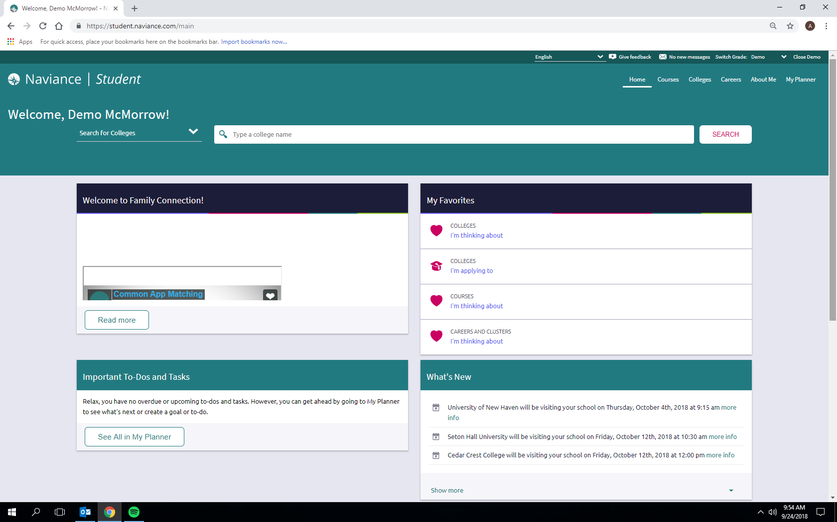

Slide 9
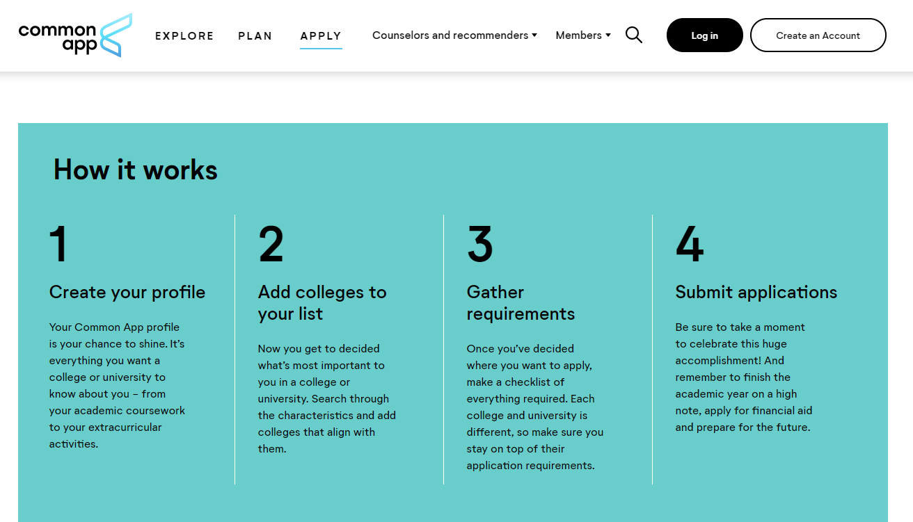

Slide 11
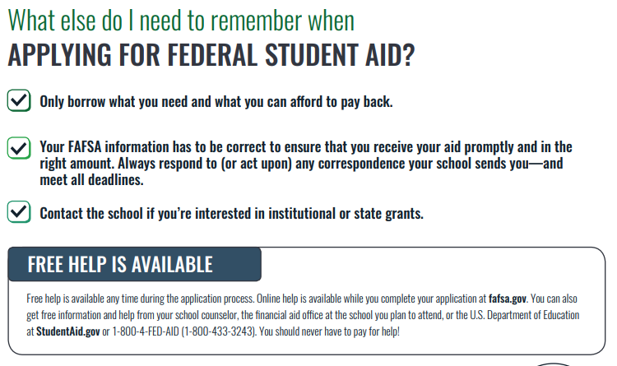
APPLY AT FAFSA.GOV (not .com!!!!)
Come to the
PAHS FAFSA night on Oct 24th at 6pm!

Slide 12
Helpful Information
Financial Aid and Scholarships
FAFSA.gov - federal financial aid application
HESAA.org - NJ State Financial aid application
Fastweb.com
Scholarships.com
Naviance Scholarship Search and List
middlesexcc.edu/admissions/nj-stars/
Testing:
Collegeboard.com
ACTStudent.org
Applications:
Commonapp.org/apply
admissions.rutgers.edu/apply-rutgers
https://www.montclair.edu/apply-to-montclair-state/

